Slide 1
FY21 PROJECTED PROFITABILITY ANALYSIS
College of Nursing and Health,
LOYOLA UNIVERSITY, NEW ORLEANS

Slide 2
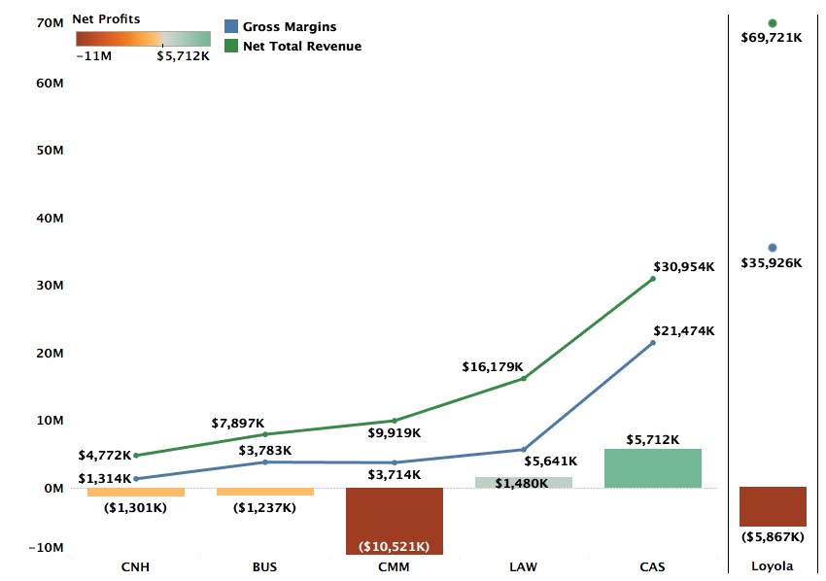
Profitability by College FY21 Projections

Slide 3
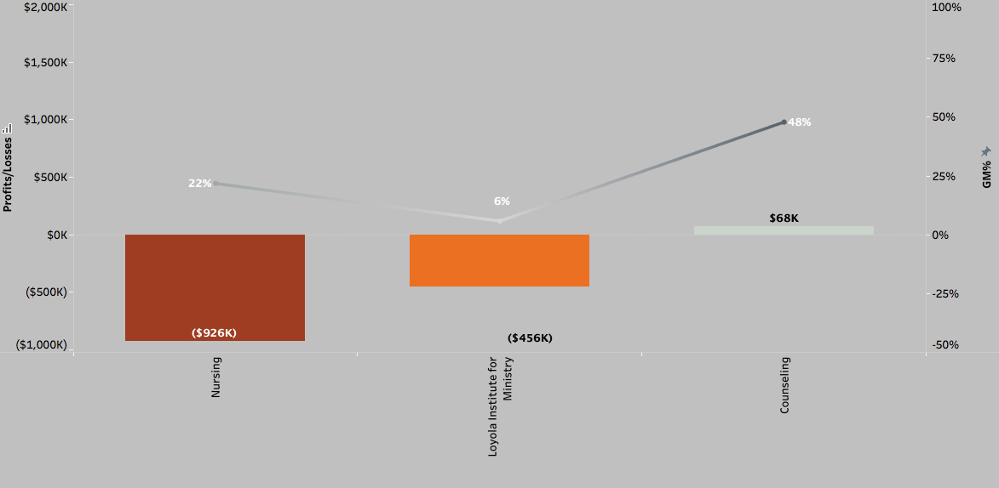
Profitability and GM% by Department (FY21 Projections)

Slide 4
DEFINITIONS
Total Revenue (TR): TR includes revenue for courses taught by the faculty of a department across all three terms, distributed revenue for courses that do not belong to a specific department, and distribution of revenues from courses of programs like Study Abroad that do not have any assigned faculty.
Avg. TR per credit (FY20) for Fall and Spring semesters is $577
Gross Margins (GM): GM = TR – Direct Costs. Direct costs include salaries, operating costs, and fringe benefits.
Avg. GM% for FY20 = 54%
Profitability = GM – Indirect Costs + Indirect Revenues. Indirect costs refer to administration costs, auxiliary costs, or college level costs distributed over departments of the specific college. Indirect revenues include auxiliary revenues, dorm revenues, and revenue from other sources.

Slide 5
Methodology FY21 Projections
FY21 Revenue Projections: Revenue projections are based on Fall 2020 enrollments and projected Spring retention rate. FY20 summer revenues are used as proxy for the FY21 summer term.
Direct Costs: Direct costs include salaries and operating costs from department budgets. FY20 fringe benefits are used as a proxy for FY21 fringe benefits.
Indirect Costs: Indirect costs in FY20 and FY21 have been higher than previous years and is reflected in department-level profitability. FY21 is also estimated to bring in lower Auxiliary revenues.

Slide 6
DEPARTMENTS WITH WORSENING FINANCIAL PERFORMANCE

Slide 7
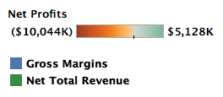
Nursing
Nursing continues to be an expensive program (21% GM in FY21 compared to the university average of 55%).
Gross Margins are also expected to decrease more than the projected decrease in TR (i.e., $770K versus 469K) due to increased direct costs in FY21.
Increased auxiliary costs with lower auxiliary revenues add to the FY20 losses and the projected losses for FY21.

Slide 8
DEPARTMENTS WITH IMPROVING FINANCIAL PERFORMANCE

Slide 9
Loyola Institute for Ministry
Lim is projected to yield a 6% GM in FY21 compared to the university average of 54%.
With $491K direct costs, there is a need for much greater enrollment as # credits in LIM declined from 1401 (FY19) to 1287 (FY20)
LIM’s TR of $378 is far below the university average of 577.
So it’s a combination of high discount rates and low enrollments that’s driving losses

Slide 10
PROFITABLE DEPARTMENTS

Slide 11

Counseling

Slide 12
Appendix (FY19 and FY20)

Slide 13
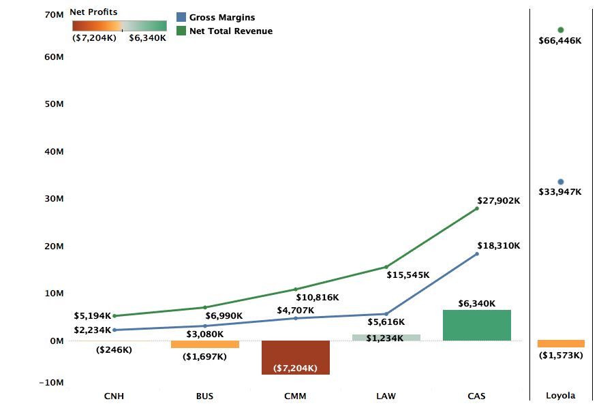
Profitability by College FY20 Actuals

Slide 14
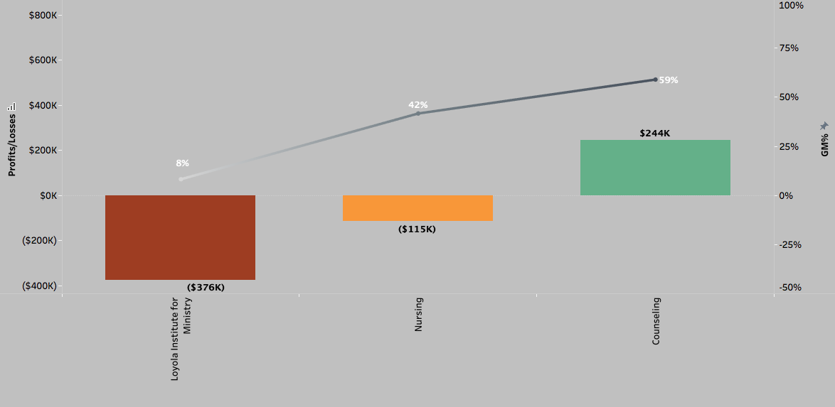
Profitability and GM% by Department (FY20 Actuals)
Notes:
Accounting is projected to be positive. All other 14 departments continue to be loss making. – Add the note on Accounting

Slide 15
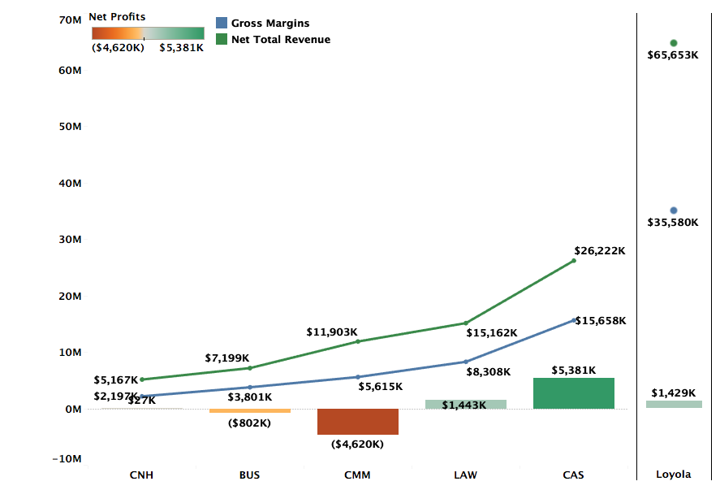
Profitability by College FY19 Actuals

Slide 16
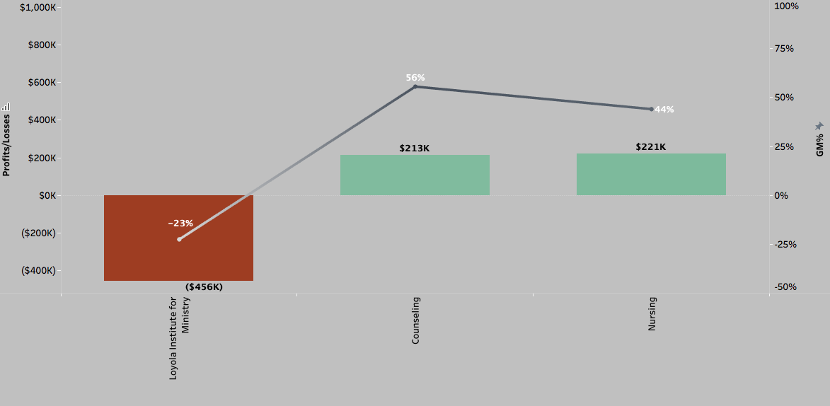
Profitability and GM% by Department (FY19 Actuals)

